Slide 1
Extracting Causal Relations from Electronics & Supply Chain News
Fiona Anting Tan Institute of Data Science National University of Singapore, Singapore tan.f@u.nus.edu
10th Feb 2023
Notes:
To extract the hidden pattern in data to understand the interrelation between factors—in future to establish causality
Open Files & Folders:
D:\66 CausalMap\Panasonic-IDS\documentation\20230210 Discussion 01
D:\66 CausalMap\SciLit_CausalMap\visualization\mir
D:\79 Mass\outs\MIR

Slide 2
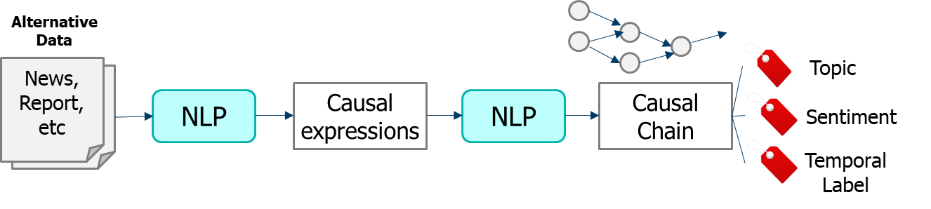
We wish to build and investigate causal graphs for summarization and hypothesis generation.
OVERVIEW
Build: Using NLP tools and store onto (graph) databases
Investigate: Based on business requirements
Electronics/Supply-Chain News
Summarization: Collect relations in supply-chain news across time
Hypothesis generation: Predict outcomes based on current event
Source: Panasonic Industry
Notes:
In this project, we wish to build and investigate causal graphs for summarization and hypothesis generation.
In a sense, most of the fundamental tools we are building based on NLP technologies and graph databases are industry agnostic. The investigation and application is the main area that requires tweaking based on business requirements.
In this project, we are working with Electronics and Supply Chain news. The immediate use cases to summarize causal relations from such news is to (1) summarize current happenings quickly, and (2) using the current chain of events, predict possible outcomes. Such a prediction tool can then be used to send alerts to users for further analysis or action if needed.

Slide 3
NLP Tools
METHODOLOGY
POS / Dependency Parsing with Stanza
Causal Sentence Classification with UniCausal
Cause-Effect Span Detection with UniCausal
Frames Parsing with OpenSESAME
Cause-Effect Argument Detection with adapted CauseNet
Cause-Effect-Signal Span Detection with 1Cademy
Causal Pair Classification with UniCausal
Notes:
#4 skipped cause too slow
#6-7 are viable to deploy, but will need 1-2 weeks to adjust to new data

Slide 4
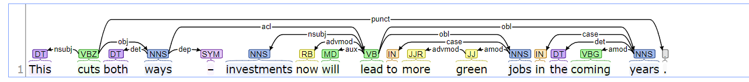
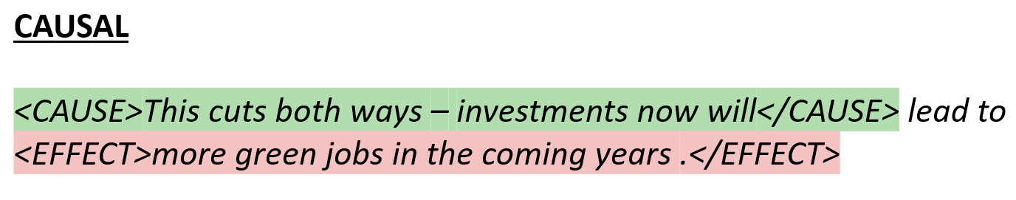
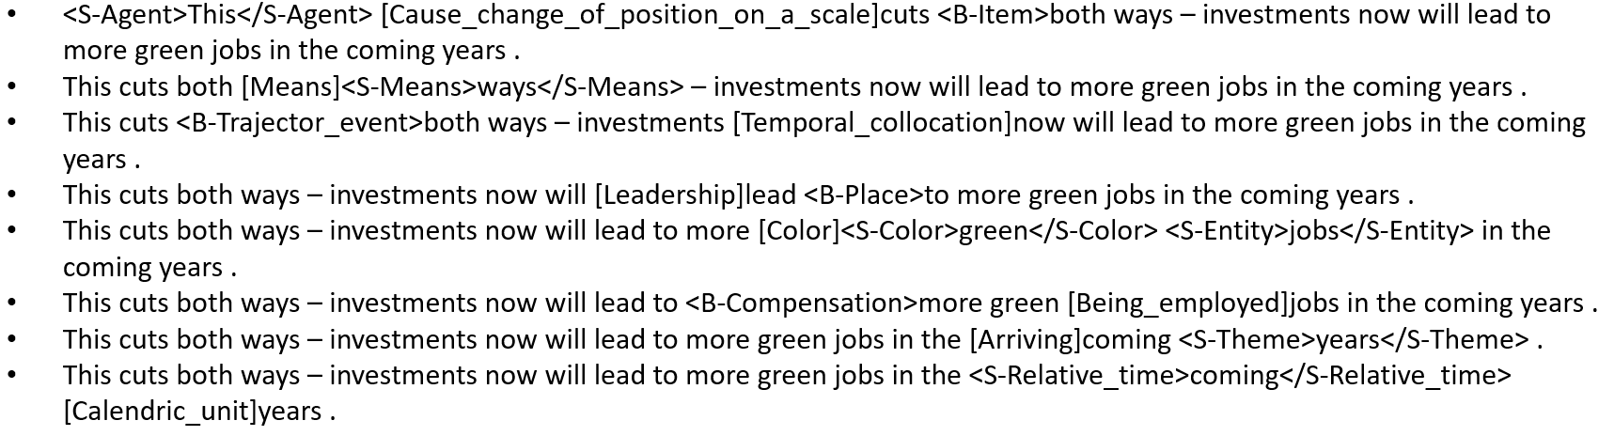
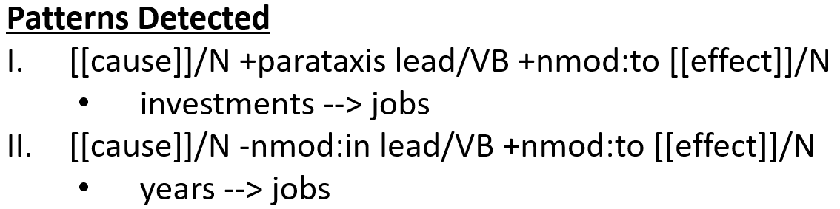
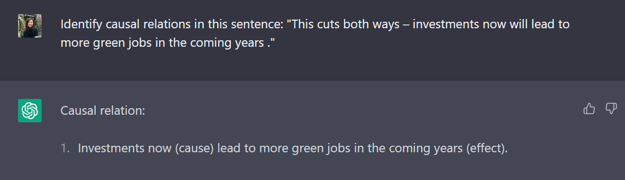
NLP Tools
METHODOLOGY
This cuts both ways – investments now will lead to more green jobs in the coming years .
POS / Dependency Parsing with Stanza
Causal Sentence Classification with UniCausal
Cause-Effect Span Detection with UniCausal
Frames Parsing with OpenSESAME
Cause-Effect Argument Detection with adapted CauseNet
Notes:
Try out:
Strict rules: # 2 = Causal, # 3 overlaps with # 5, create other sanity checks with # 1 & # 4
Nothing much might be extracted
Relaxed rules: # 3 pairs if # 2 = Causal / # 5 any pairs detected / # 4 if verb type is Cause
Gibberish might be extracted

Slide 5
Outline
METHODOLOGY
Extract NLP information using tools
Clean up UniCausal Causal Examples
Link up same arguments that are sequential in text (`join_neighbouring_args`)
For multiple relations in a sentence, we match the Cause and Effect spans by order (this is an assumption/ quick fix)
Clean up CauseNet Causal Examples
Link up relations in same sentence, with same causal pattern, and one same argument (`combine_causenet_args`)
Align UniCausal and CauseNet Causal Examples
Grouping and Stemming Arguments

Slide 6
Data & Findings
FINDINGS
Original Data
6384 articles
Extracted Data
214 relations from 231 sentences
Cleaned Relations
170 relations
335 nodes
Simple visualization at: http://localhost:5006/mir
Notes:
From
6384 articles
[Steps 1-4] Extraction & Clean →
214 relations
231 sentences
Avg support: 1.079
[Step 5] Clean & Map →
170 relations
Thoughts: Are we filtering away too many relations?
Show nodes:
Pandemic
Filtering
F-193

Slide 7
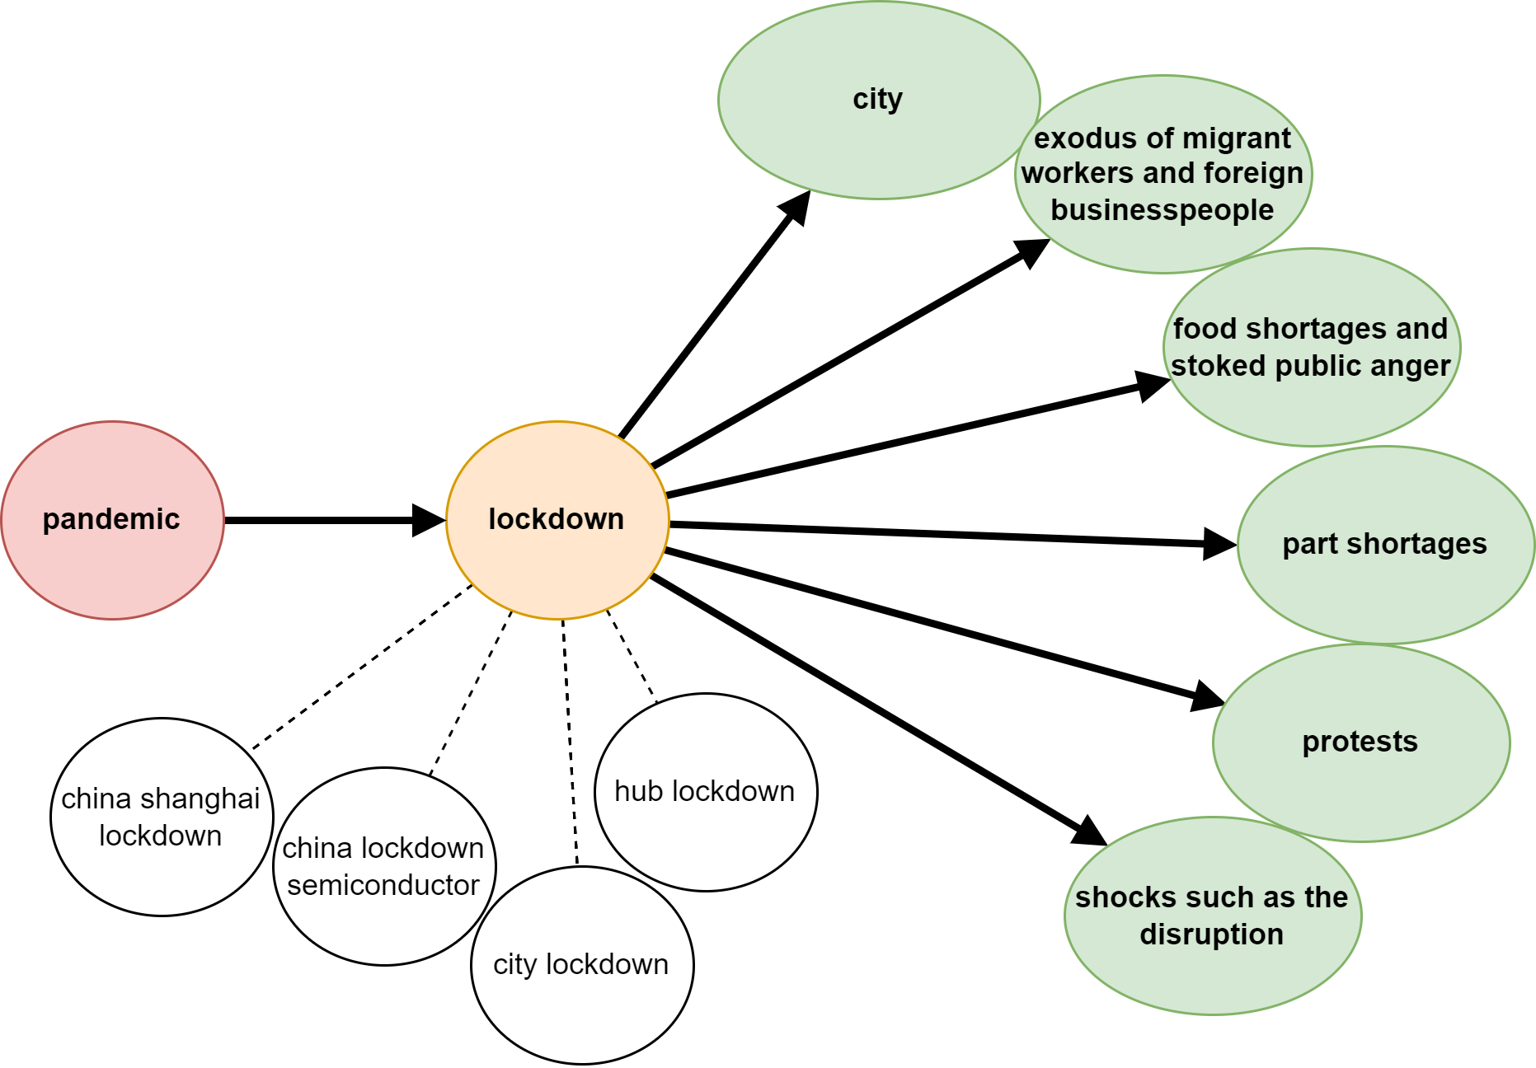
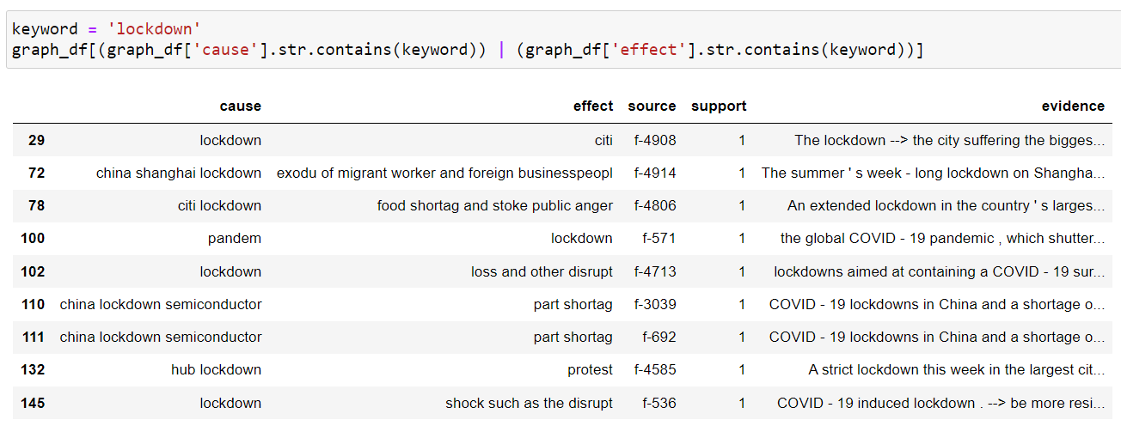
Data & Findings
FINDINGS
Issue 4
Notes:
Filtering the graph to show any nodes that contain the word “lockdown” reveals interesting chain of relations:
pandemic → lockdown → many things
A key to producing such a graph is knowing how to group the root nodes by “lockdown”. This is non-trivial, and also requires some brainstorming.
The next few slides highlights some issues we need to iron out, for a better extraction…

Slide 8
Issues for Discussion
FINDINGS
Duplicate data
Long sentences/paragraphs
Multiple causal relations per sentence
Strategy to group nodes
Causal relations curation rules

Slide 9

Duplicate Data
FINDINGS
Duplicates based on text column, i.e. Column H (“Translated”).
Duplicates typically arise from “Geography” (E.g. same news appearing under Global, China, etc.).
There seems to be a possible bug because, at times, the same article can be tagged to different Month-Year. E.g.:
After de-duplicating, 9126 → 6384 unique articles.
Notes:
Why are there these duplicates?

Slide 10
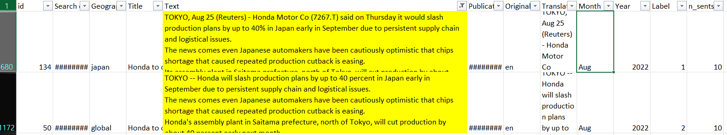
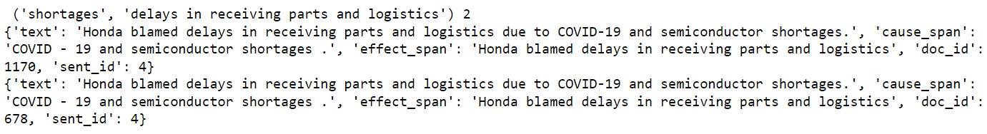
Duplicate Data
FINDINGS
Even after deduplication, there are articles that are very similar, which we did not remove:
This arbitrarily skews up support of such sentences:
Notes:
Should I remove exactly same sentences (from different articles)? Or ignore/act as if they don’t exist (small sample size anyway)
→ verdict: Maybe repeated entries <1 support, e.g. this example gets like 1.5 support or smth

Slide 11
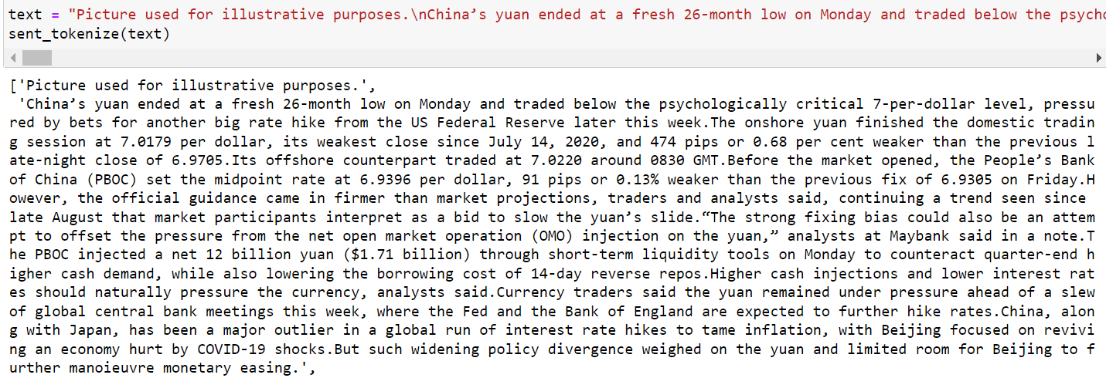
Long Sentences/Paragraphs
FINDINGS
Sentence tokenizer doesn’t work for examples with poor spacing, E.g.:
This affects downstream extracting, especially since most NLP NN models have maximum sequence length.
Should we re-tokenize and re-run the code?
Notes:
Main impact:
Extraction not possible for information presented at the back of sequences
Should we re-tokenize and re-run the code?

Slide 12
Multiple causal relations per sentence
FINDINGS
Current model cannot handle multiple relations in one sentence:
<ARG1>Many battery makers are ramping up production</ARG1> <ARG0>to meet</ARG0> <ARG1>soaring worldwide demand</ARG1> <ARG0>as car makers accelerate</ARG0> <ARG1>their shift to electric vehicles</ARG1> <ARG0>to comply with tougher emission rules aimed at tackling global warming .</ARG0>
to meet (soaring worldwide demand) --> Many battery makers are ramping up production
as car makers accelerate (their shift to electric vehicles) --> soaring worldwide demand
to comply with tougher emission rules aimed at tackling global warming . --> their shift to electric vehicles
Ignoring these examples means we lose learning from such event chains;
We could explore other NLP tools???
Notes:
Again, #6-7 are viable to deploy, but will need 1-2 weeks to study and adjust to new data
Many battery makers are ramping up production to meet soaring worldwide demand as car makers accelerate their shift to electric vehicles to comply with tougher emission rules aimed at tackling global warming .

Slide 13
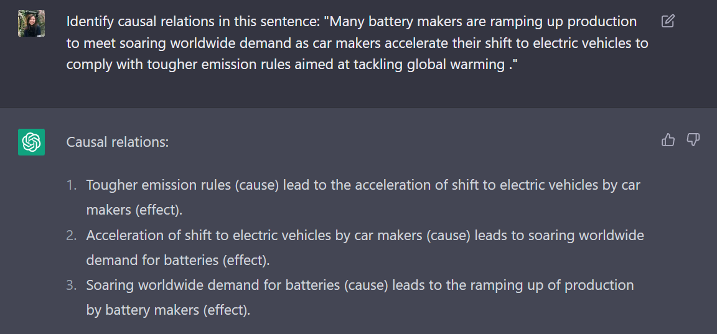
Notes:
Successful case – and on multiple causal relations!

Slide 14
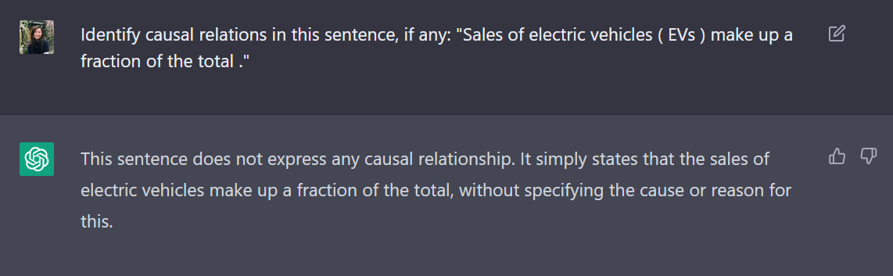
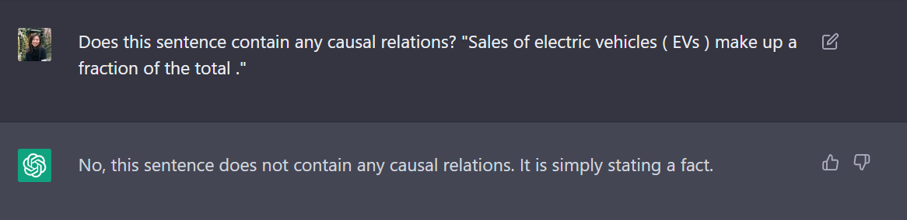
Notes:
Successful case

Slide 15
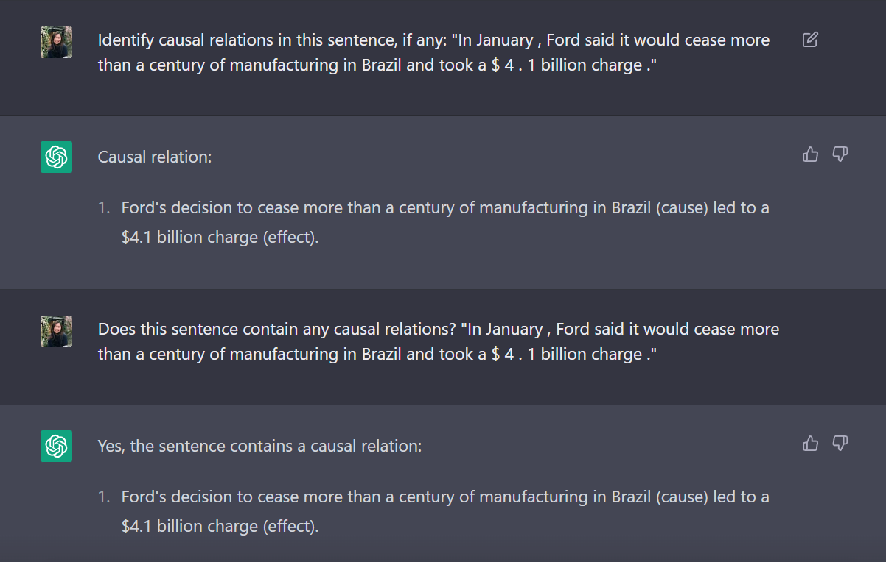
Notes:
Failure cases – Identify wrongly

Slide 16
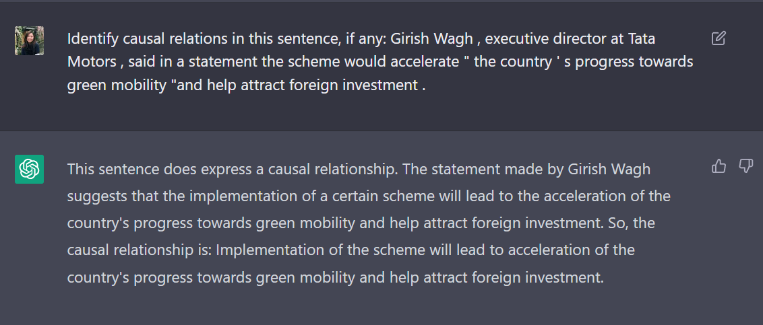
Notes:
Failure cases – Cannot identify

Slide 17
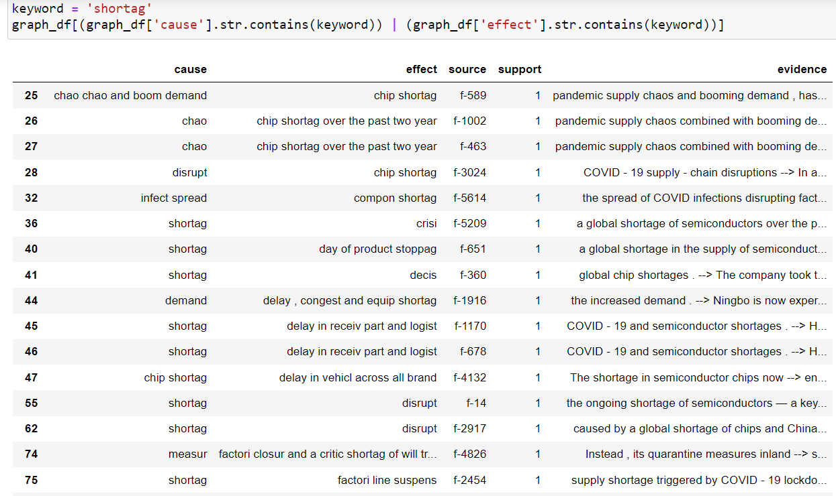
Strategy to group nodes
FINDINGS
Stemming helps to a certain extent
How to do final grouping of nodes?
See E.g. “lockdown” vs “shortag”
Need to discern:
Location [Can be same?]
Agent/Patient [Needs to be different?]
Time [?]

Slide 18
Timeline
Notes:
Review timeline given any additional work

Slide 19
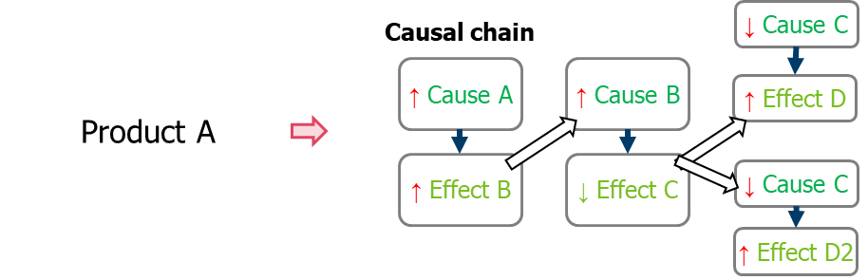
Discussion
Causal relations curation rules: All, add levels to the CE extracted
Prototype data size: Full dataset, or split by quarters
Evaluation strategy: TBD
Product identification
Temporal & sentiment aspect
Importance of other relation types
Cross-sentence relations
Source: Panasonic Industry
Notes:
Other details:
6384 unique articles, 55354 sentences in total to work with.
Should we prototype with all the articles or just a subset?
Are you sure causal relations are the only thing worth analysing? If the aim is to survey current trends and news, I think we need more than causal relations. It’s more of summary, highlight impactful sentences (maybe sentences with a lot of events), and maybe the causal part is a small point to note.
Multi-sentence issues
Issues after curating relations (can discuss later):
Synonyms/co-reference resolution/generalization issues

Slide 20
Applied research publication venues:
JAN - NAACL Industry Track: https://2022.naacl.org/calls/industry/
FEB - KDD Applied Data Science Track: https://kdd.org/kdd2022/cfpAppliedDS.html
JUN/JUL - EMNLP Industry Track: https://2022.emnlp.org/calls/industry_track/
AUG - Innovative Applications of Artificial Intelligence (IAAI): https://aaai.org/Conferences/AAAI-23/iaai-23-call/
Notes:
1. Create a Causal Chain (1 to 5 above steps) tuned to Panasonic Database
2. Add time aspect to the Causal Chain Time recognition NLP
3. Add Sentiment aspect to the Causal Chain Based on pre-defined sentiment model

Slide 21
CONCLUSION

